Slide 1
MICROCONTROLLERS AND EMBEDDED SYSTEMS LAB INSTRUCTONS

Slide 2
INSTALLING KEIL VERSION 5
https://drive.google.com/open?id=1UsKoigmJPAQKYTv27084Nyd4FKicAPKy
First install mdk528a and then install the patch MDK79525 from the above link.
Keil microvision 5 is an IDE supporting editor, assembler, compiler, simulator and debugger.

Slide 3
CREATING A PROJECT
Create a folder with your USN on the Desktop.
Open Keil microVision 5.
If there are any projects already open, go to projects tab on the top and close it.

Slide 4
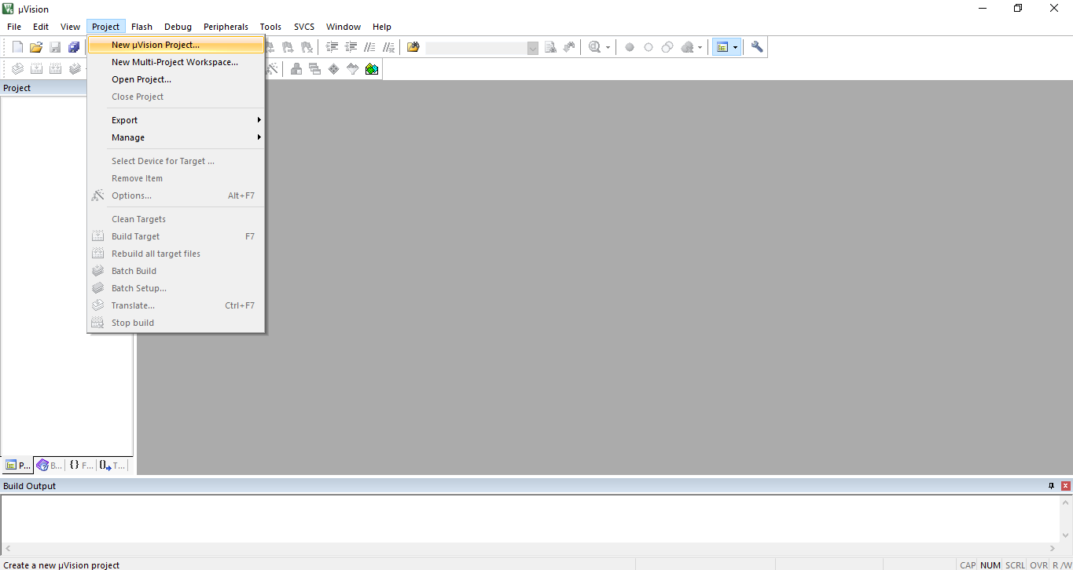
Go to Project->new microvision Project.

Slide 5
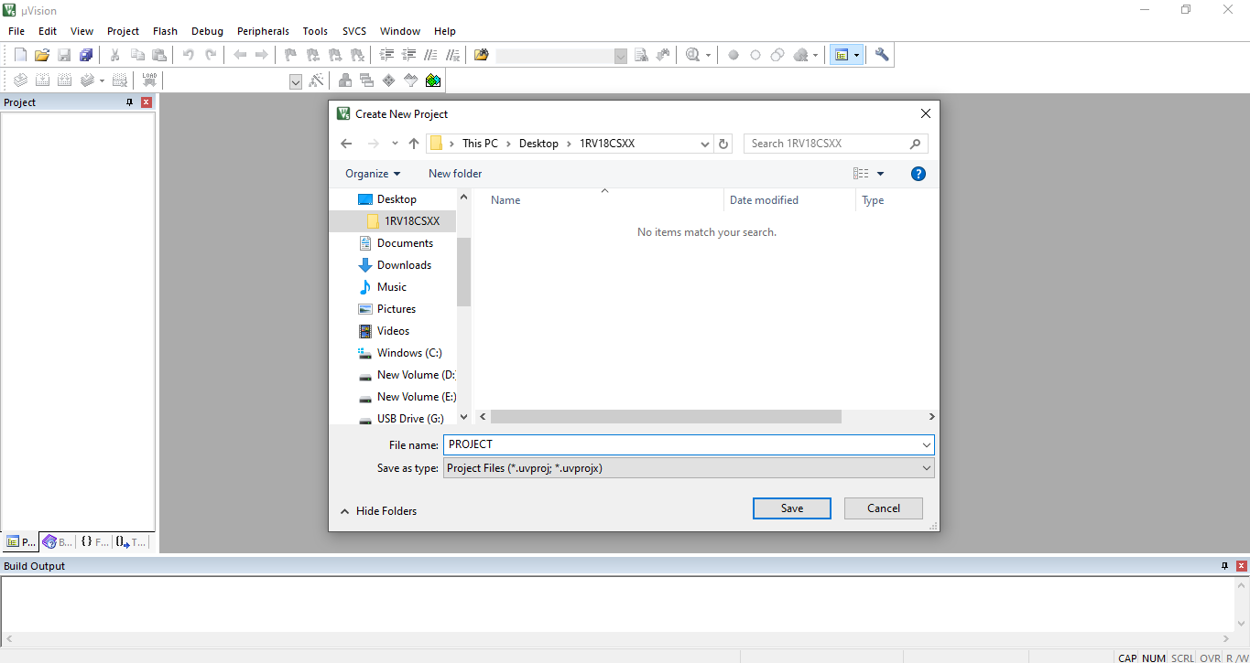
Give your project a name and save it in the folder created earlier.

Slide 6
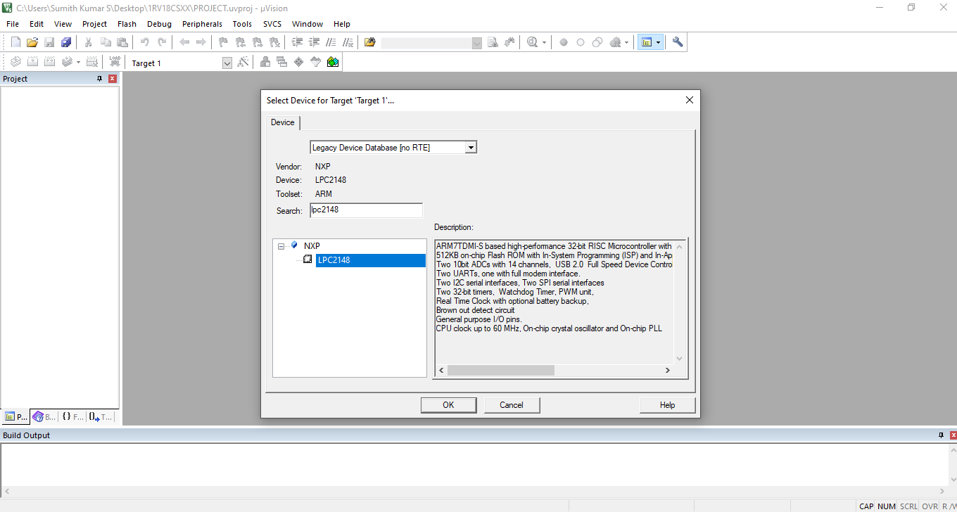
Select Device as ‘Legacy Device Database’ and search for ‘LPC2148’ and select it.

Slide 7
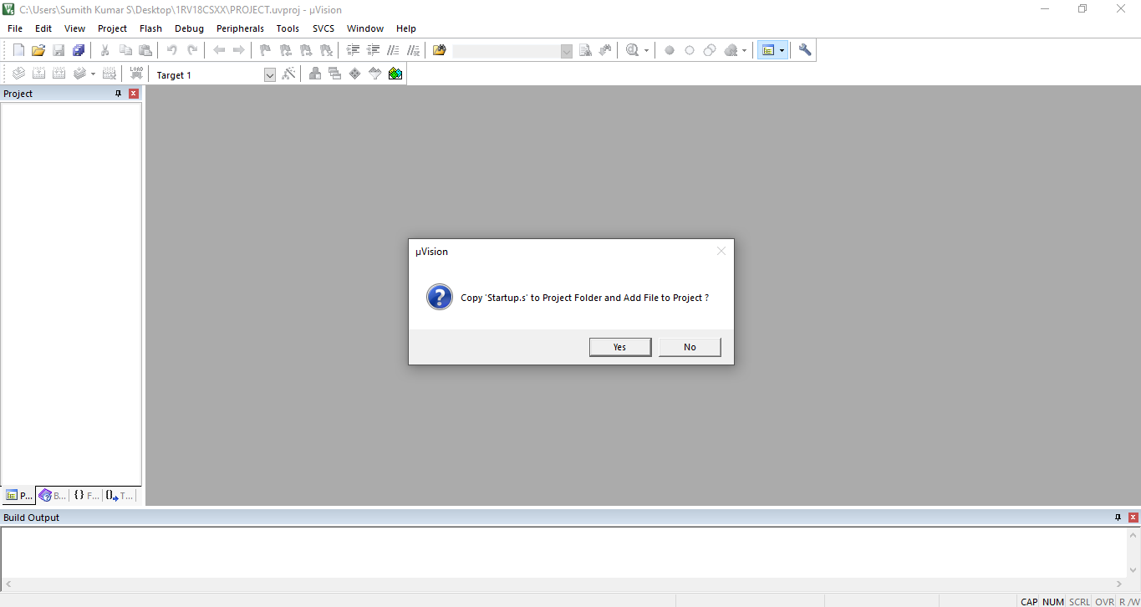
For the above window select No and proceed.

Slide 8
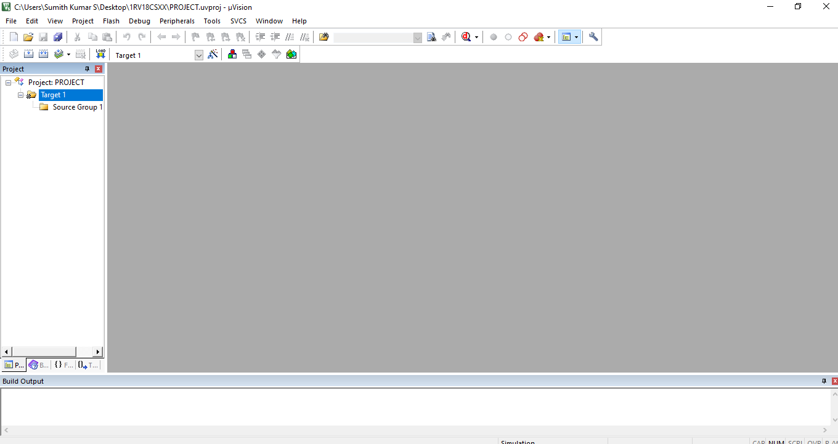
We can see that the project is created.

Slide 9
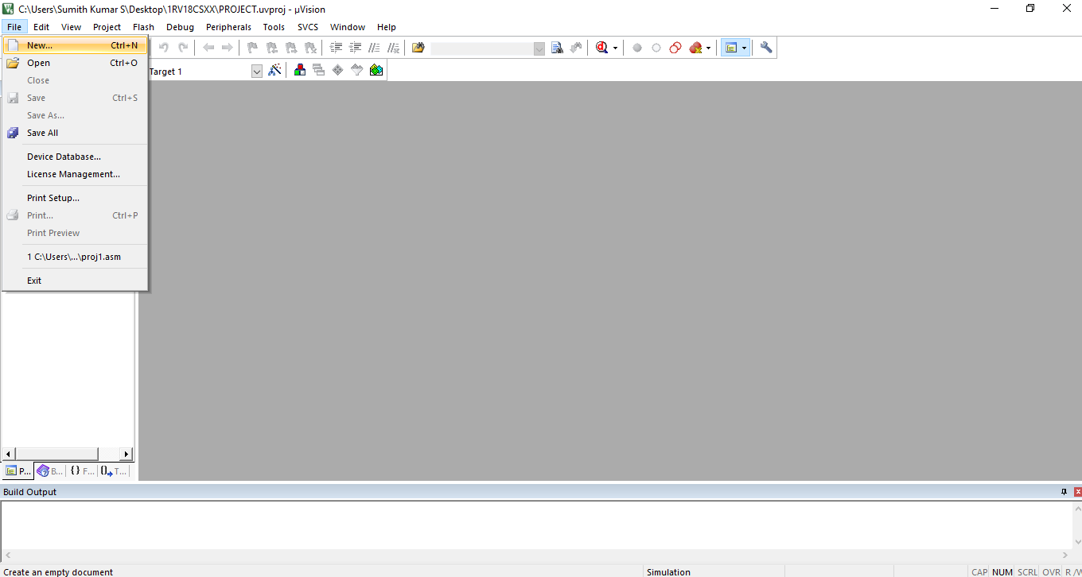
Click on File->New and create a file.

Slide 10
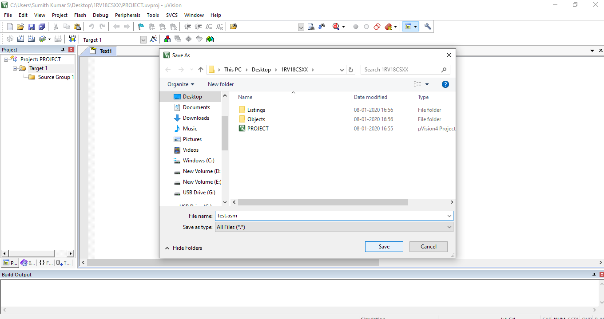
Immediately save the file created with .vsm extension.

Slide 11
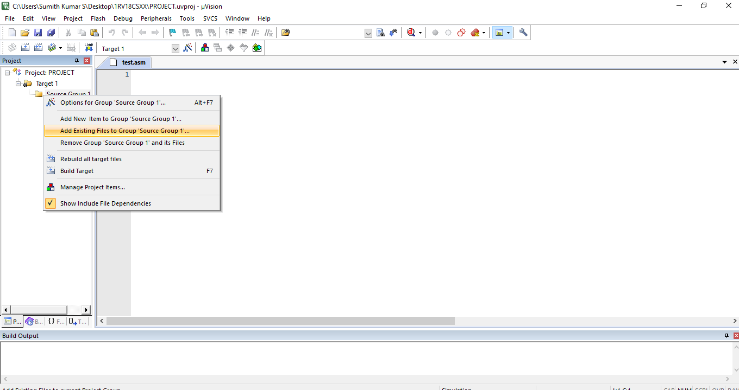
Right click on ‘Source Group’ and select ‘Add Existing Files to Group’.

Slide 12
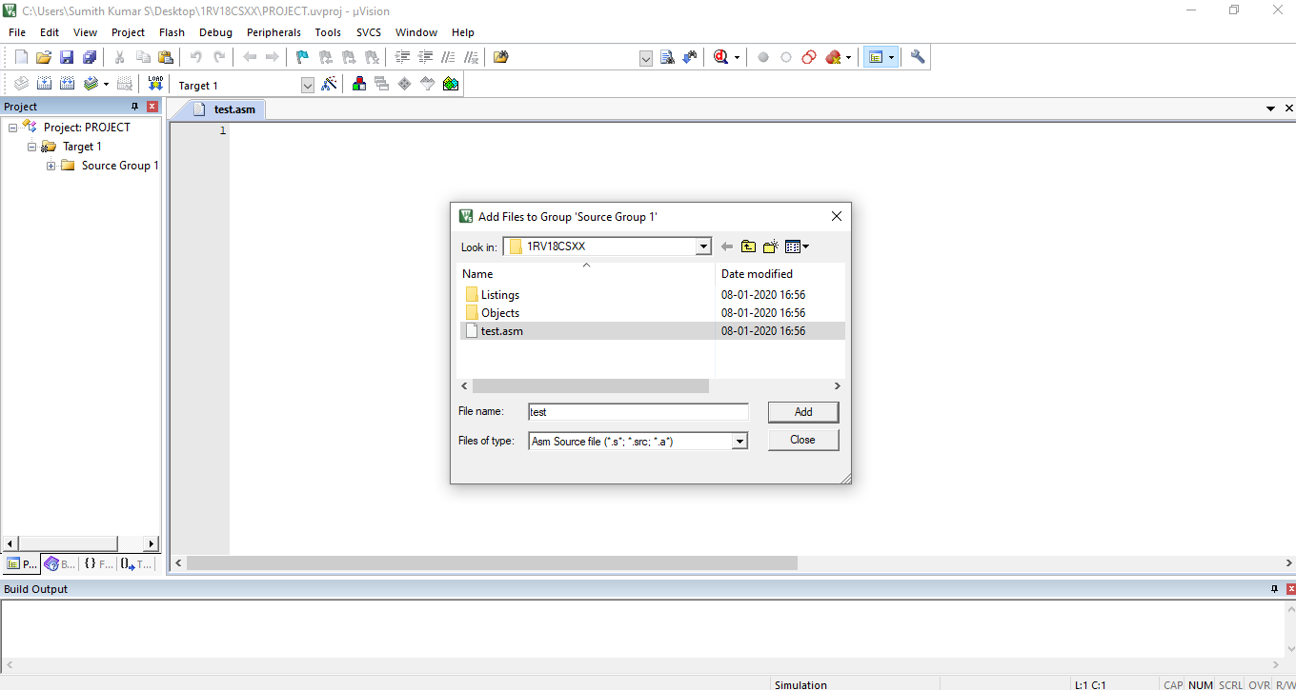
See that the ‘Files of type’ is Asm Source file and select the file which was created earlier.

Slide 13
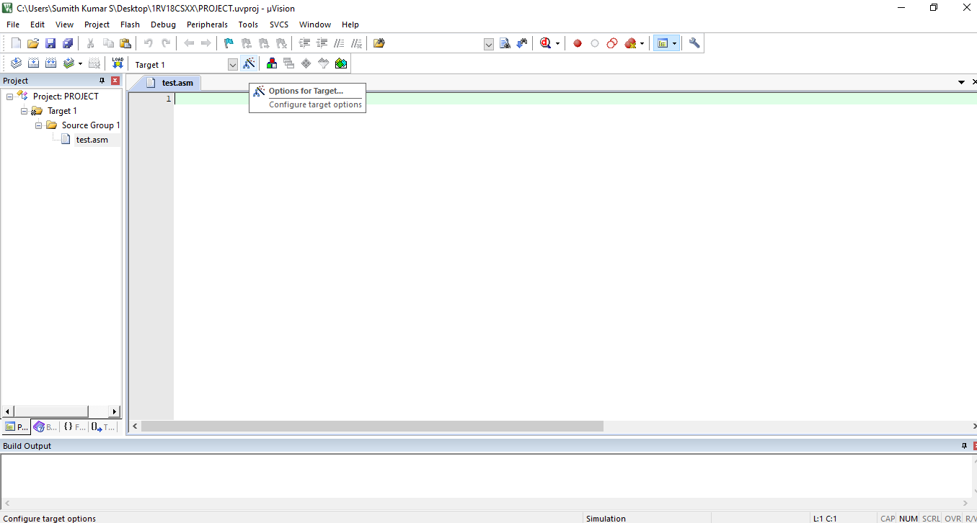
We can see that the file test.asm is added to the ‘Source Group’.
Next click on ‘Options for target’ as shown above.

Slide 14
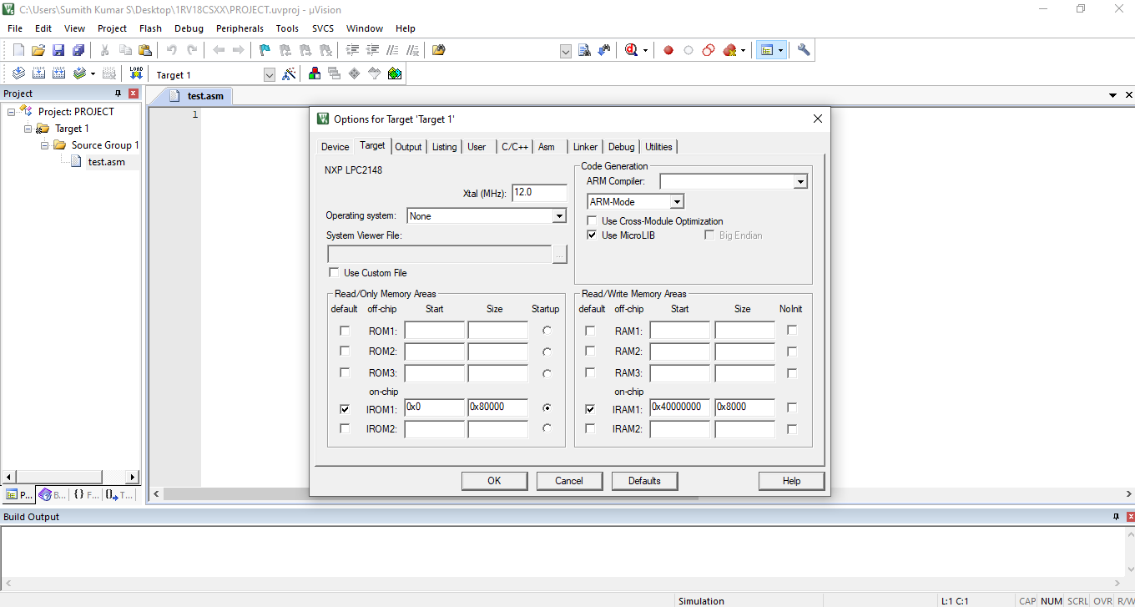
Under the Target section, check the Use MicroLIB which is present in ‘Code Generation’.

Slide 15
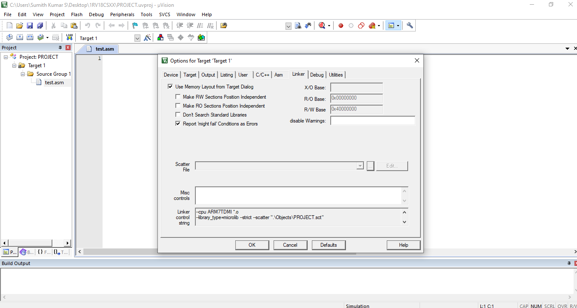
Under the Linker section, check the ‘Use Memory Layout from Target Dialog ‘ and click on OK and close it.

Slide 16
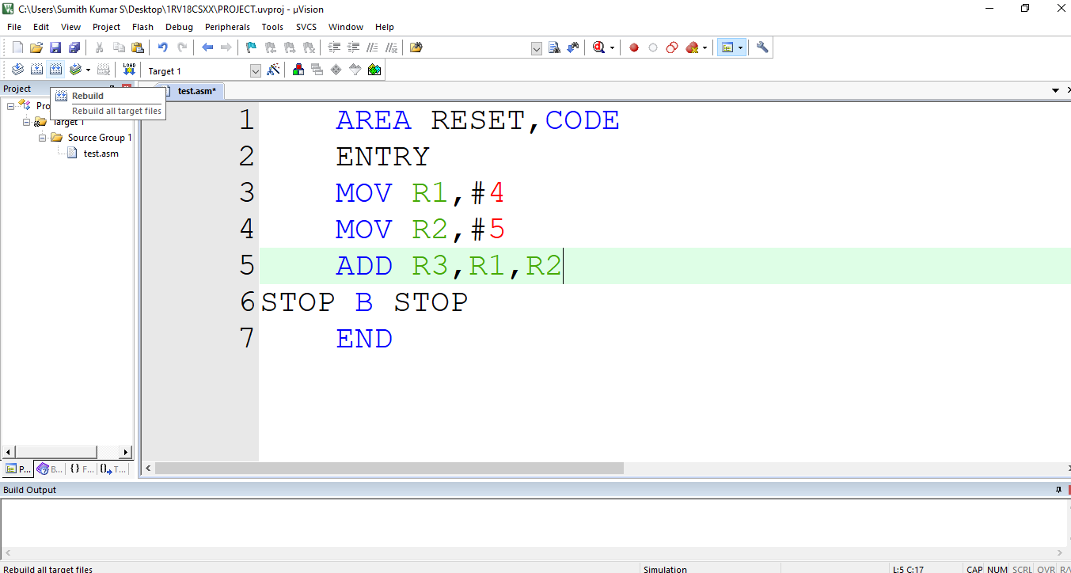
Now we can start writing Assembly Language Programs.
Above is a sample program to add 2 integers and store the sum in register R3.

Slide 17
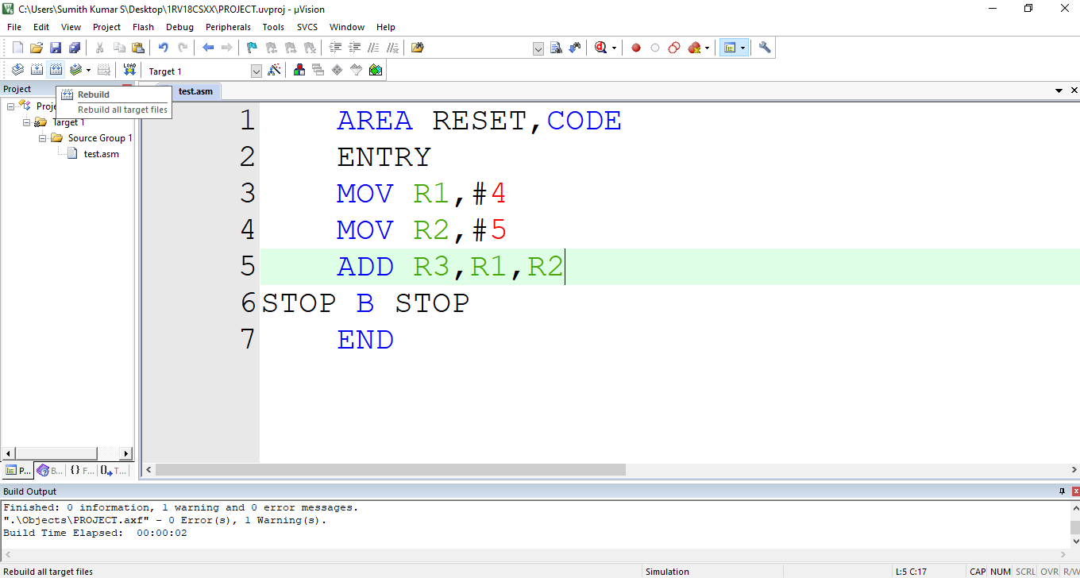

After write the ALP, in order to build it, select the build option as shown above. We can build only one file or all the files at once.

Slide 18
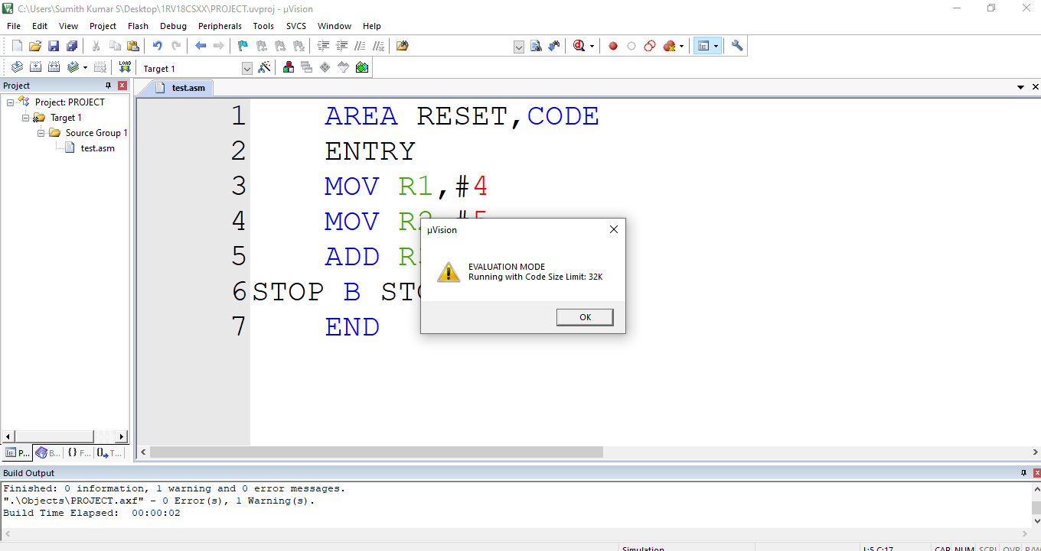
We can execute programs of size only less than 32K. Select OK for the above window.

Slide 19
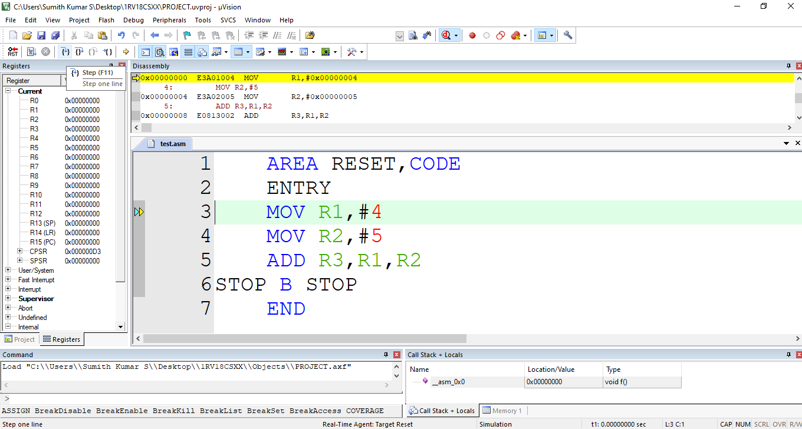
To run program step by step select the option shown above and observe the content of the registers.

Slide 20
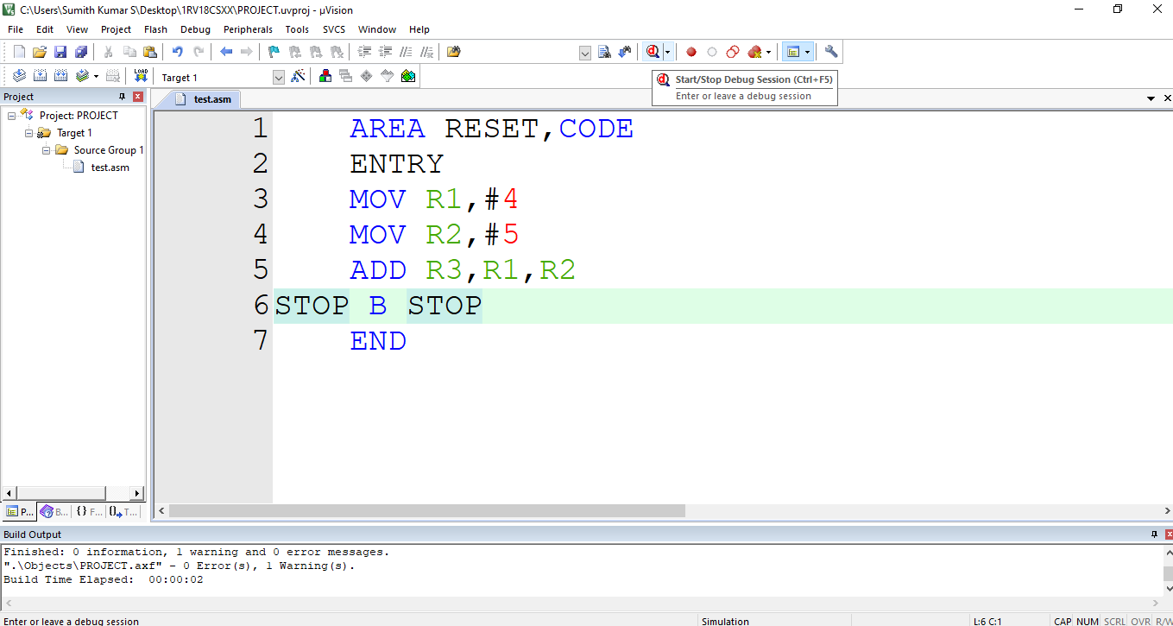
If you need to make any change to the code, select the debugger and modify the code and build the code and then execute.

